Slide 1
Interactive Delaunay Triangulation
Stephen Ranger

Slide 2
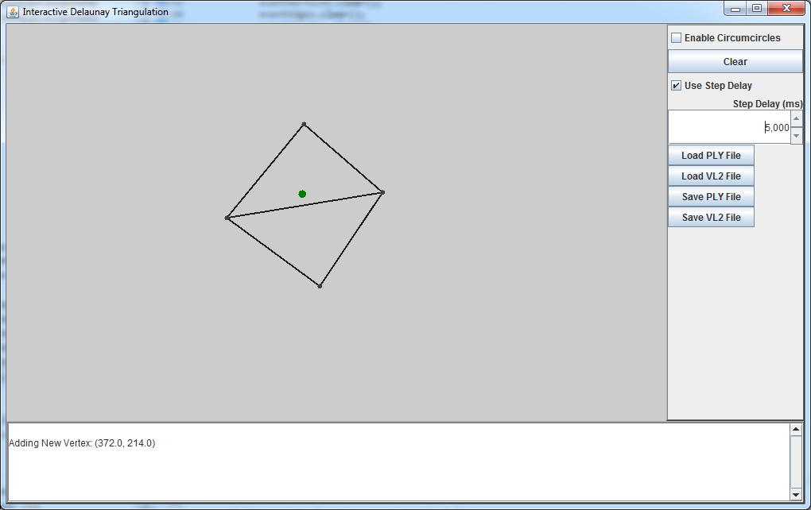
Algorithm
Adding a new Vertex

Slide 3
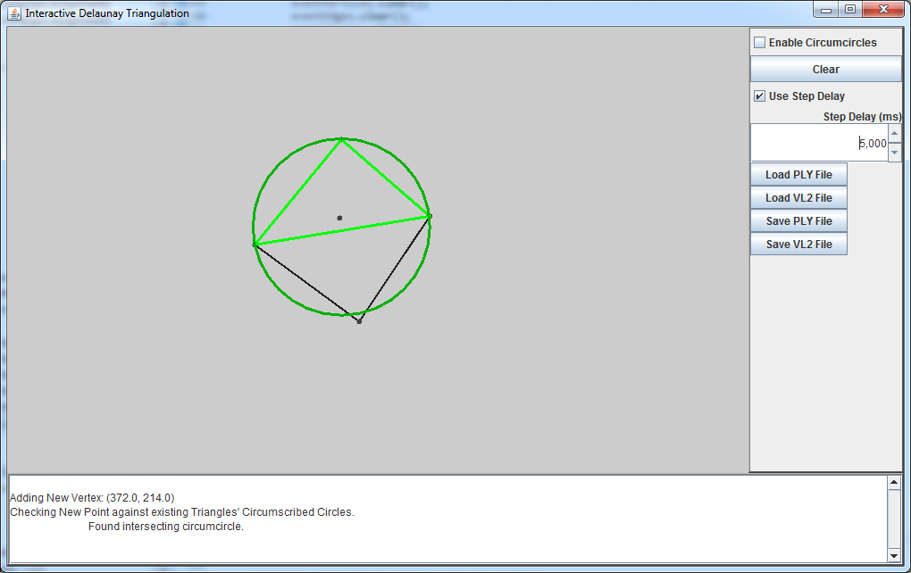
Algorithm
Check Vertex against circumscribed circles for each triangle currently in the mesh

Slide 4
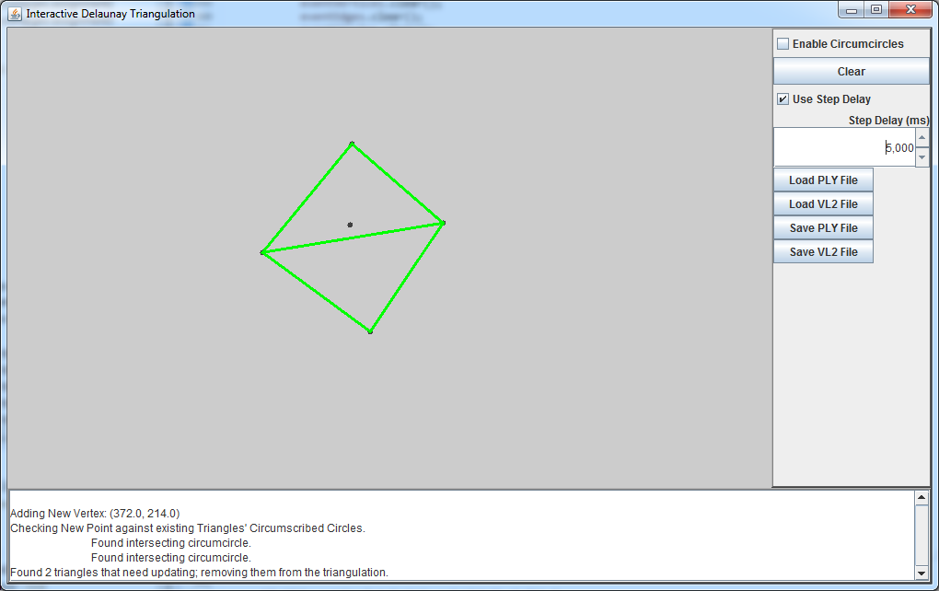
Algorithm
All marked triangles are then removed from the mesh

Slide 5
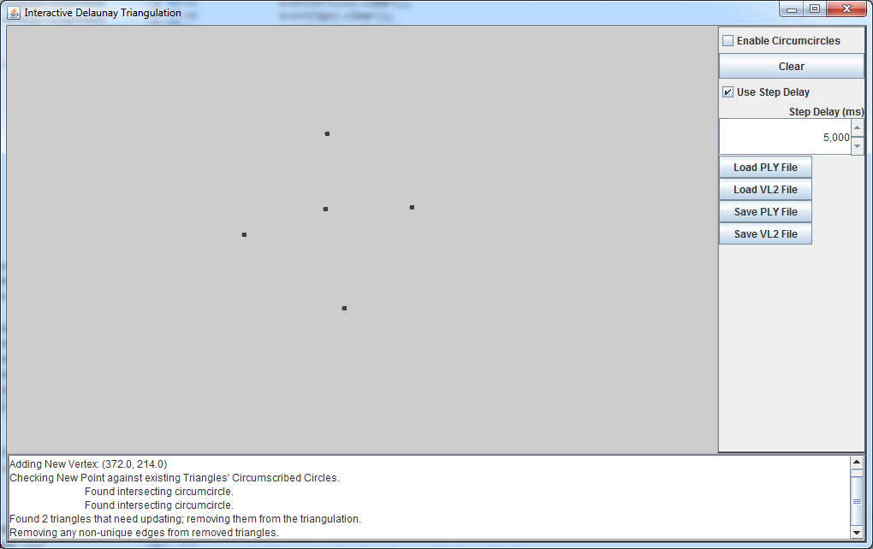
Algorithm
For each circle that contains the vertex, mark to be removed

Slide 6
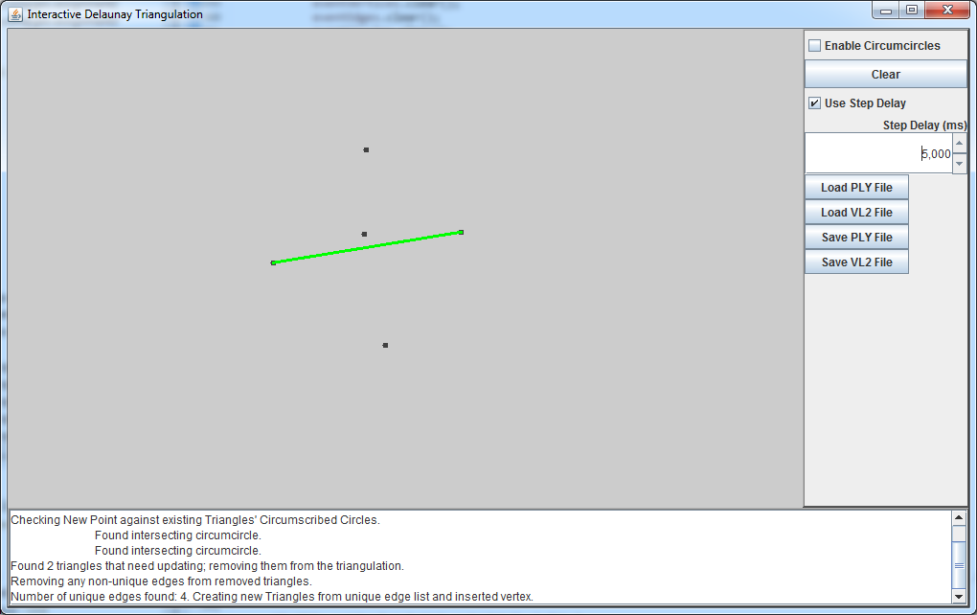
Algorithm
Remove all internal edges of the marked triangles

Slide 7
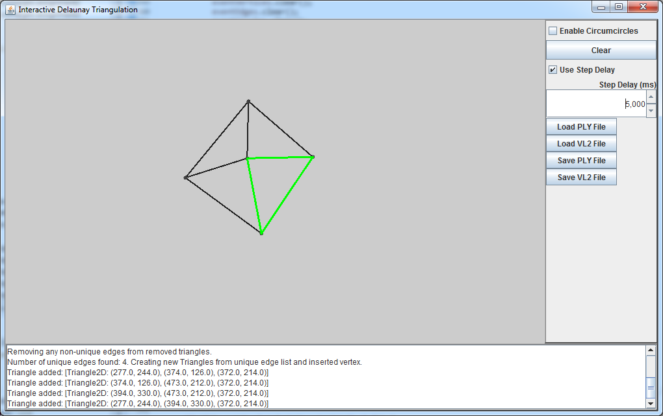
Algorithm
For each external edge in the group of marked triangles, link with new vertex to create new triangle

Slide 8
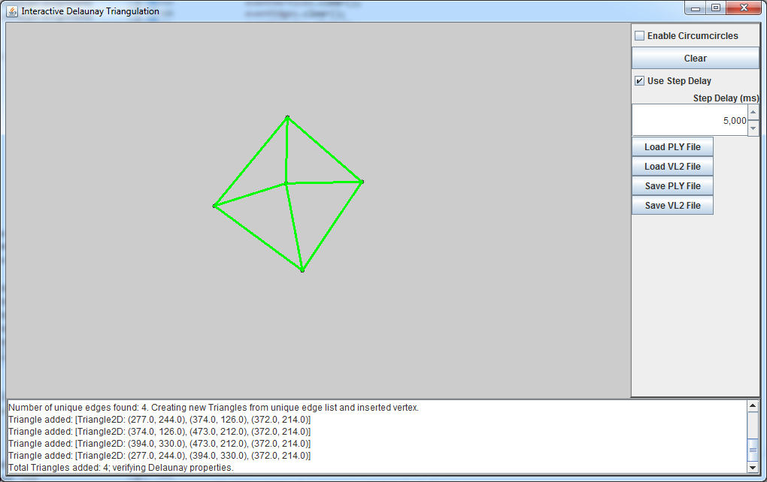
Algorithm
Addition of new triangles now complete

Slide 9
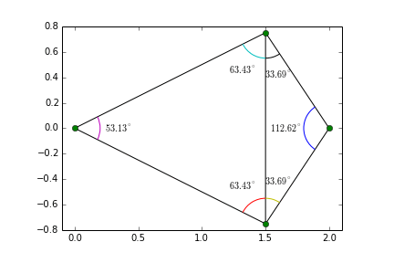
Algorithm
Check all new triangles for Delaunay validity
  if the angles of the opposite corners of any neighboring pair of triangles exceeds 180 degrees, the adjoining edge is flipped

Slide 10
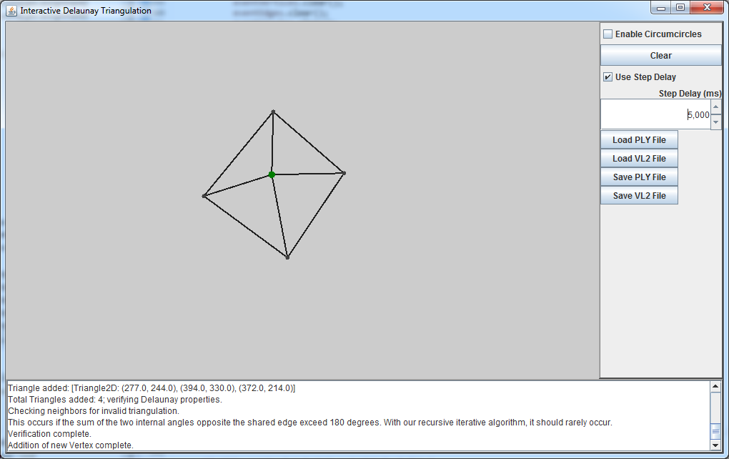
Algorithm
Vertex insertion complete

Slide 11
Problems Encountered
Three co-linear points create an invalid triangle
Duplicate points don't insert well
Inserting large amount of points can be very slow
  Addition of triangle partition map would help searching for circumscribed circles
Point insertion is not parallelizable
  Causes invalid triangulation and crossing edges

Slide 12
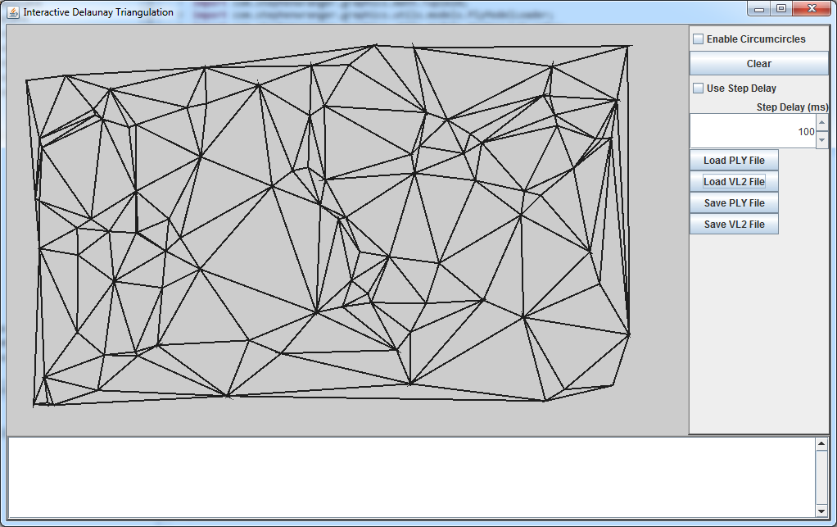
Demo!
Time For a Demo

Slide 13
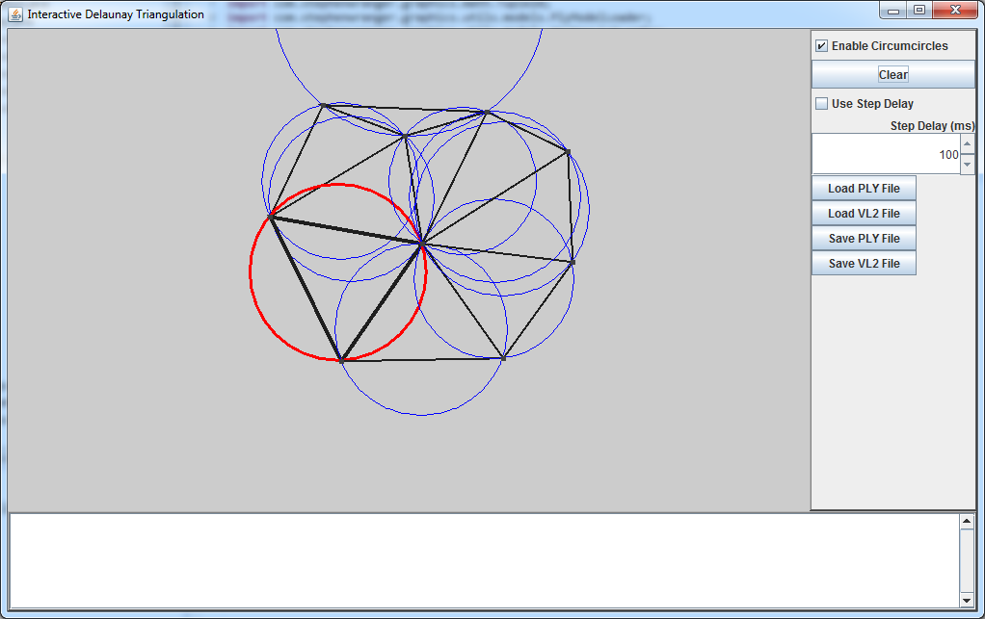
Questions?

